Slide 1
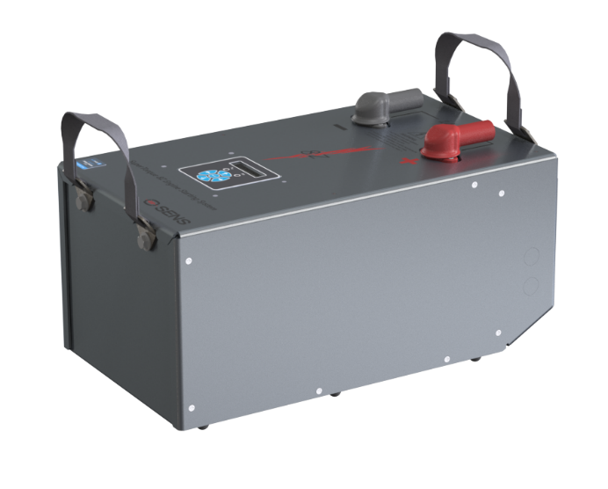
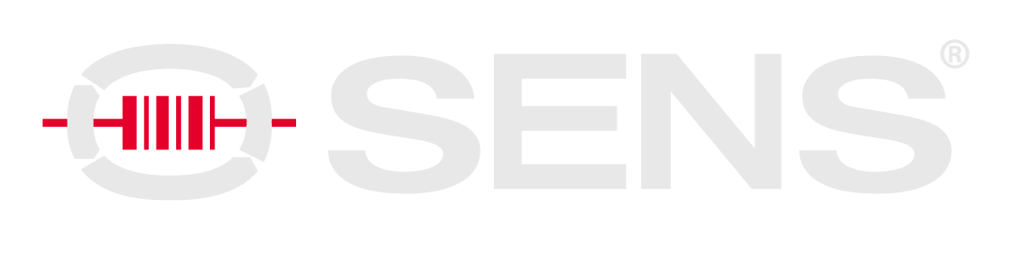
Modernizing Genset Starting Systems

Slide 2



Agenda
Existing Solutions
Nickel-Zinc
SuperTorque 8Z
Questions

Slide 3
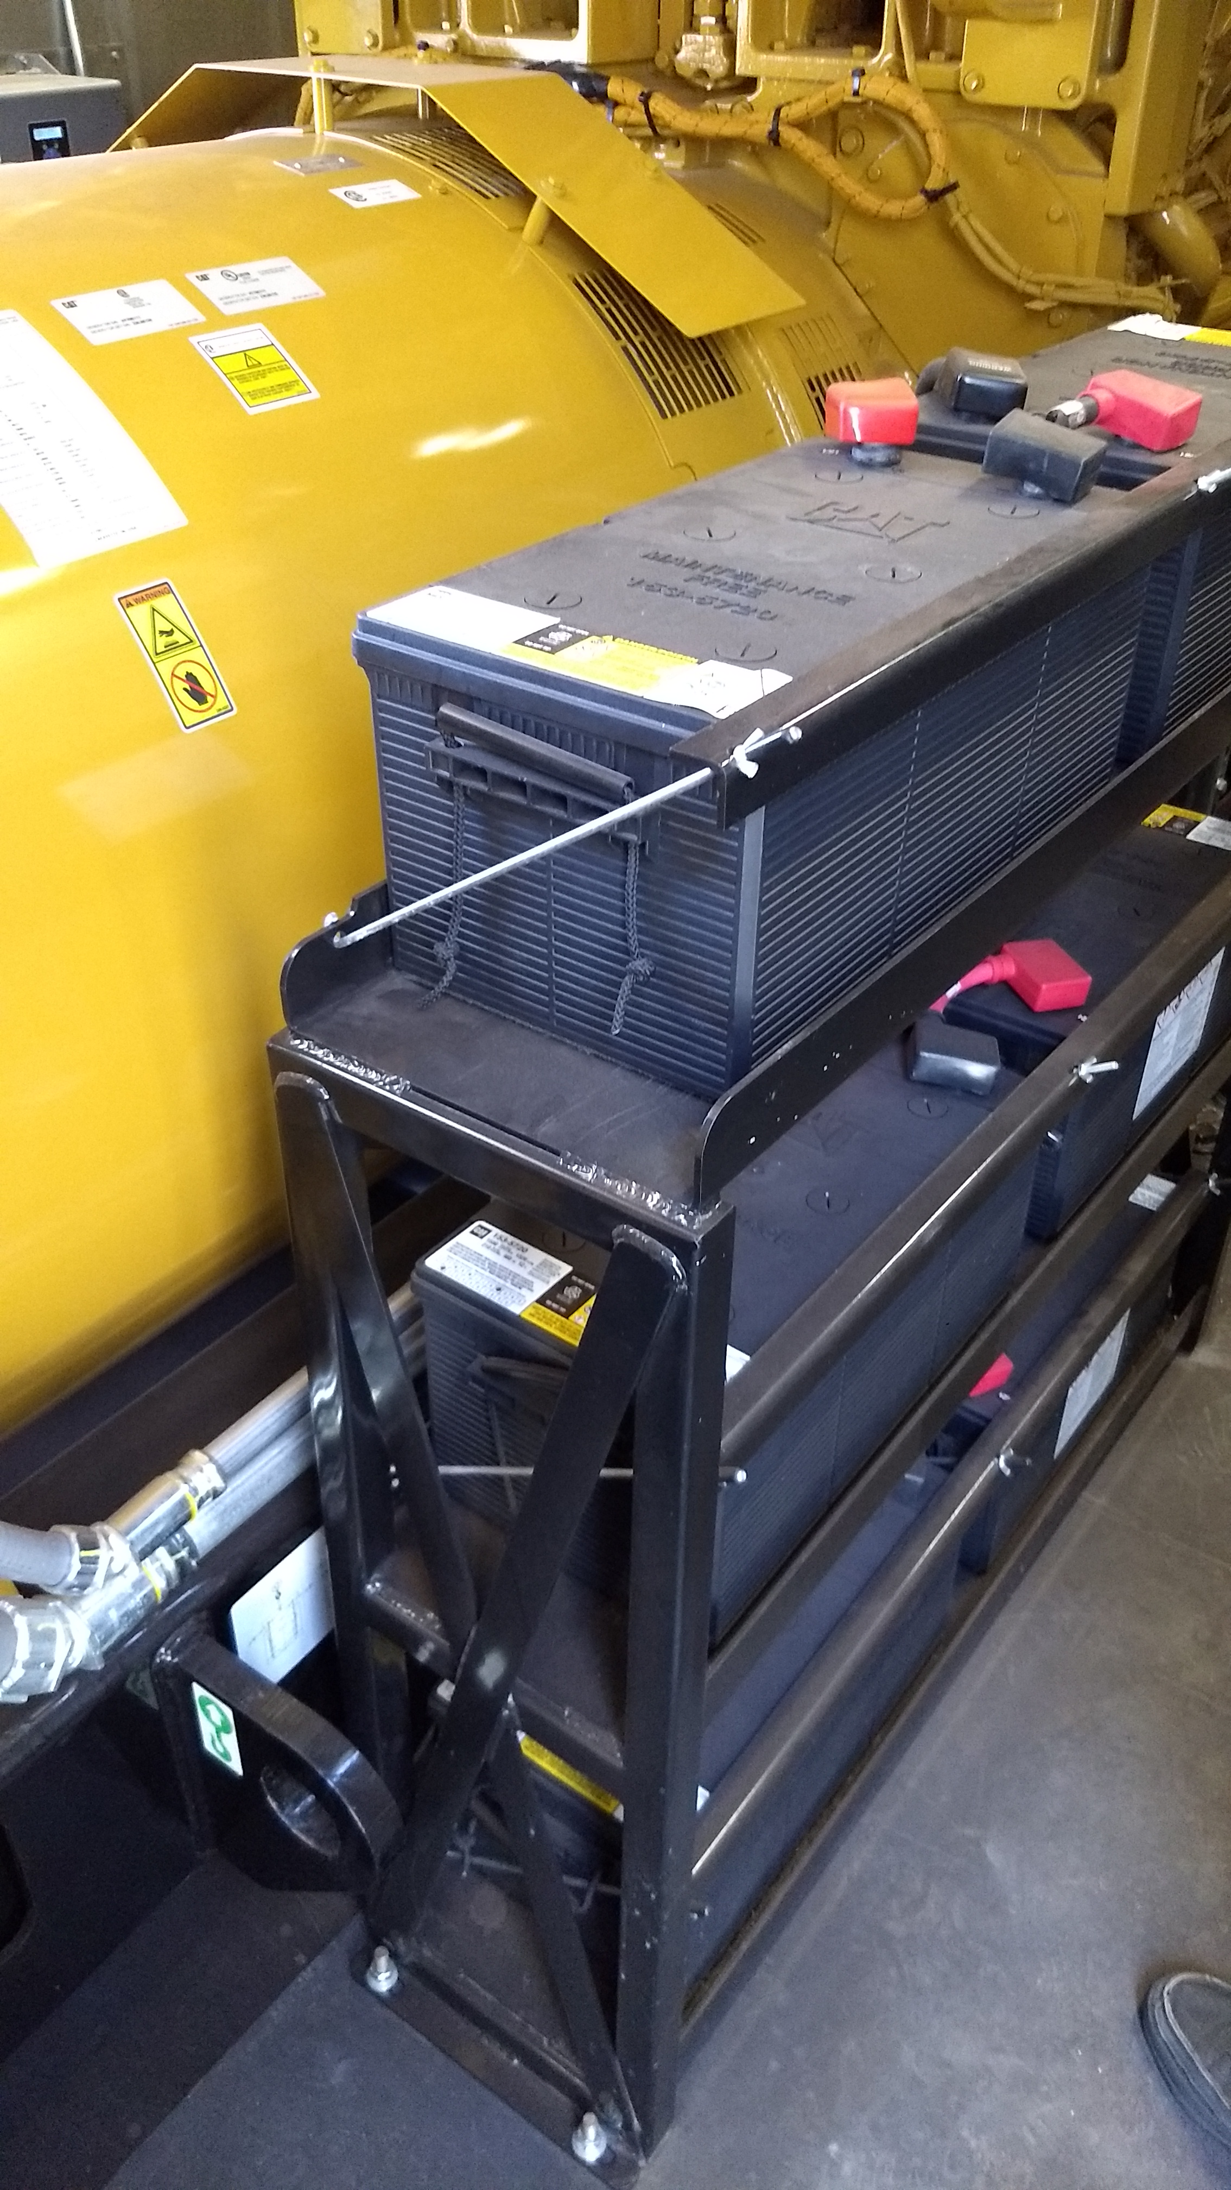
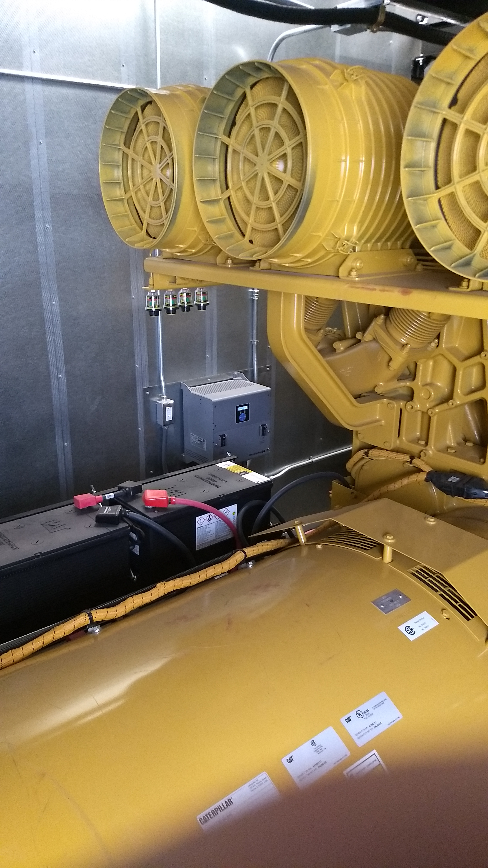
Existing Genset DC Starting Solutions
Lead-acid or NiCad batteries
Dedicated battery Chargers
Coupling through a best battery selector
Complex installations
Regular maintenance required

Slide 4
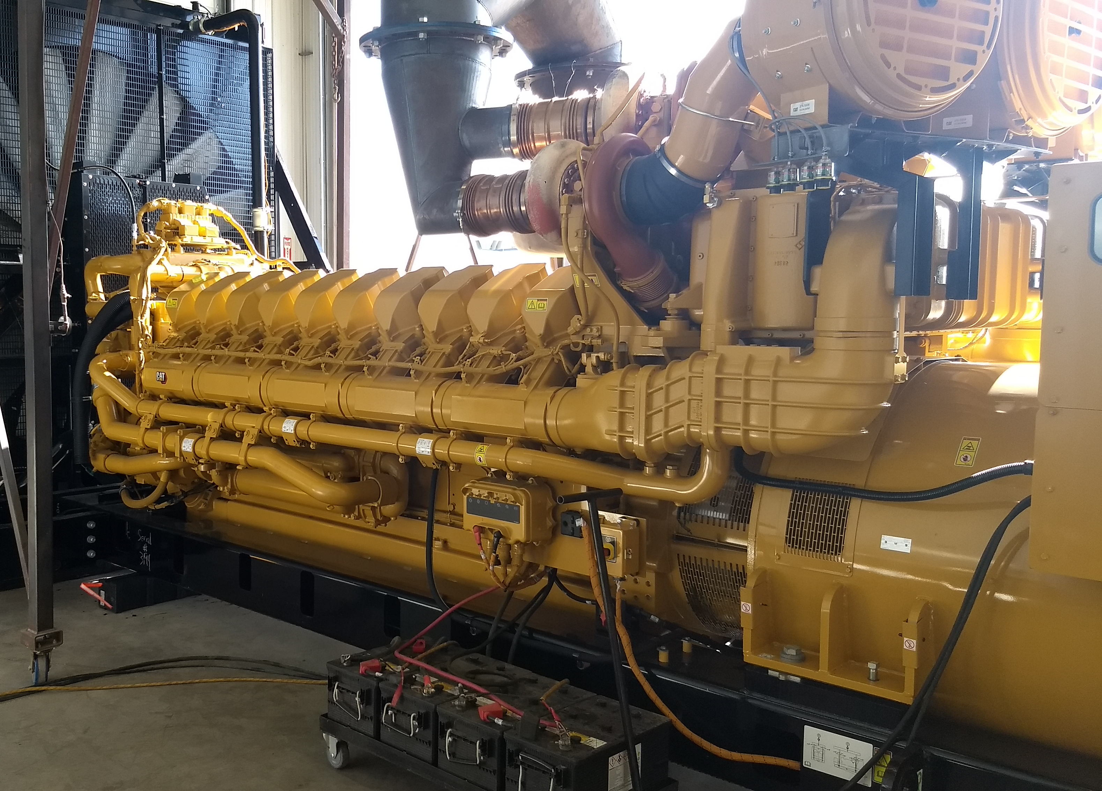
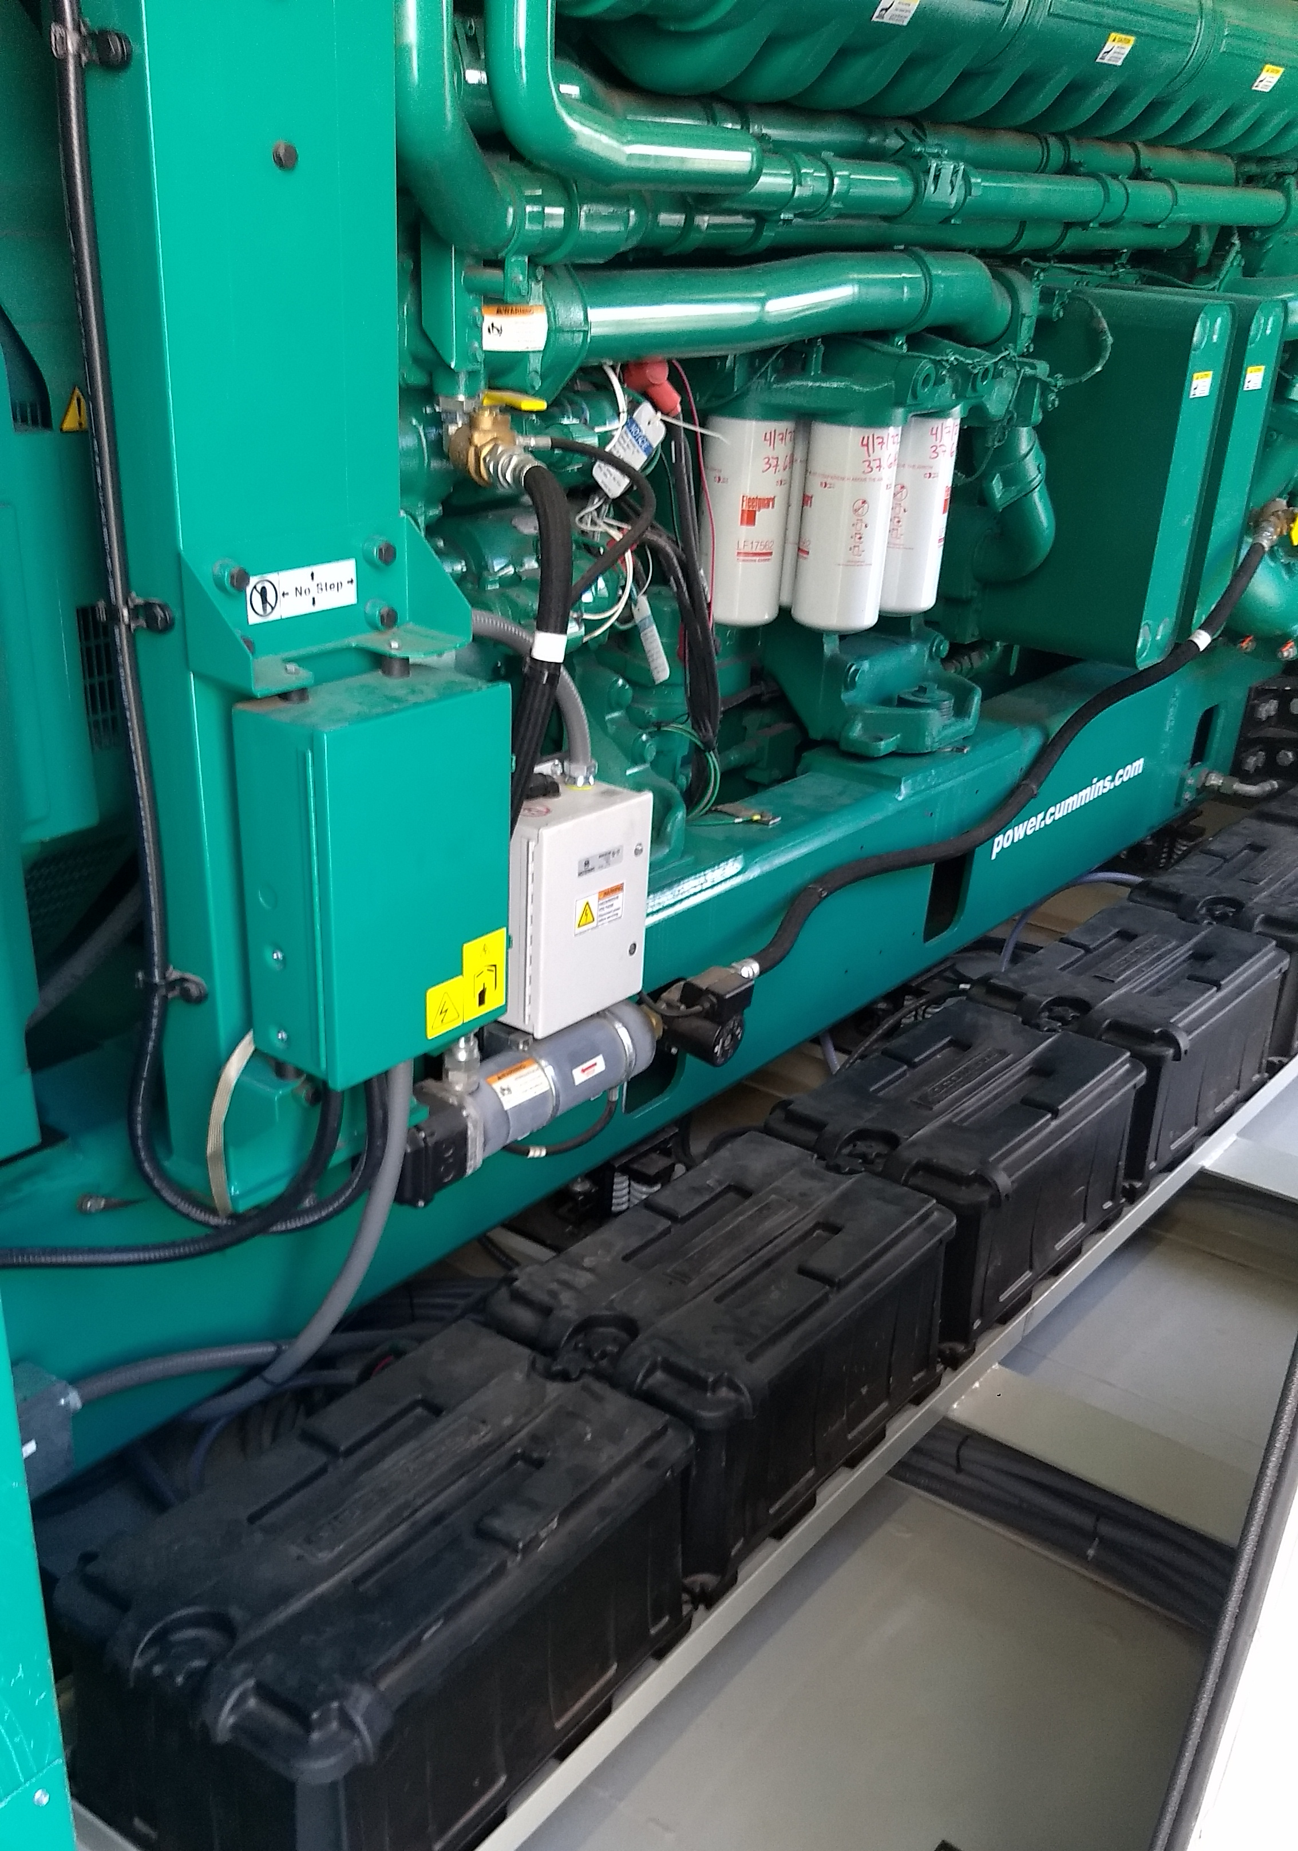
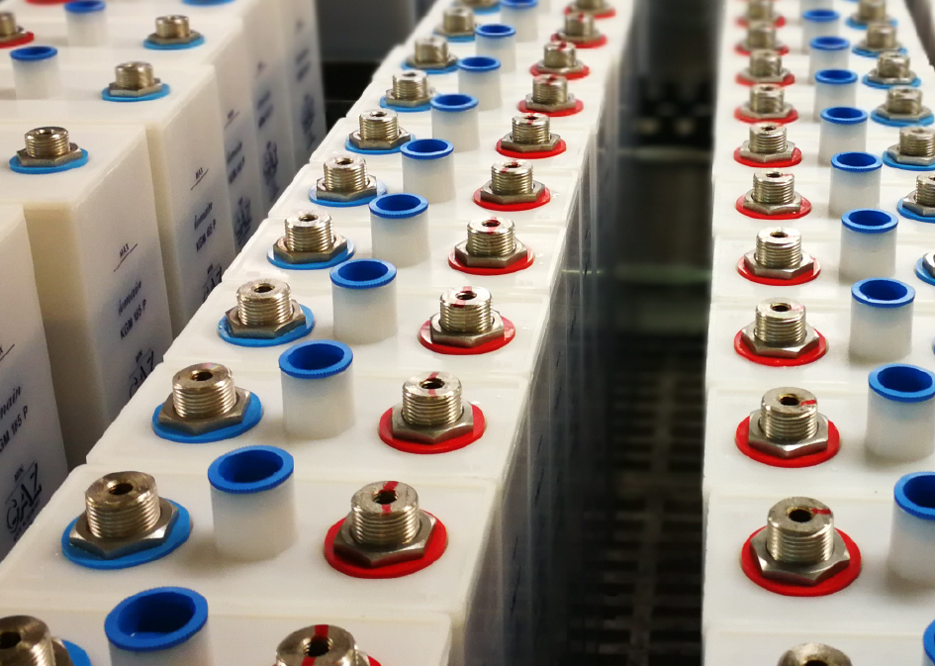
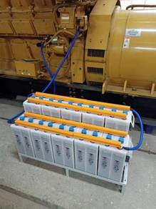
Existing Chemistries
Genset Starting Batteries
Lead-Acid
Low Capex, High Opex
Unreliable –> 2-3 year replacement cycle
Sudden, catastrophic failure
Regular maintenance by trained technicians
Logistical Issues: Replacements, service, size & weight, disposal
Nickel-Cadmium (NiCad)
High Capex, High Opex
10-20 year service life
Complex installations
Regular maintenance by trained technicians
Logistical Issues: Cost, complexity, service, size & weight

Slide 5
Nickel-Zinc
An Alternative Battery Chemistry
High discharge current applications
  Datacenter UPS
  Engine Starting
Better Temperature Performance
Higher Power Density
Longer Life
Delivers reliable performance, safely
  High engine-cranking performance even at low state-of-charge
  Much more efficient use of battery capacity compared with lead-acid
Green

Slide 6
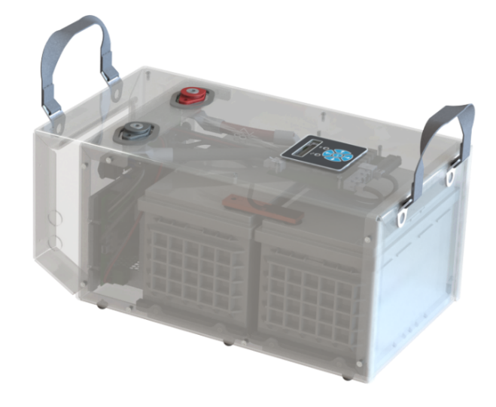
SuperTorque 8Z
An Integrated Genset Starting System
Nickel-Zinc Battery Bank
Integrated SENS MicroGenius 2 Charger
Internal charge control, UI, Communications
Plug and Play

Slide 7
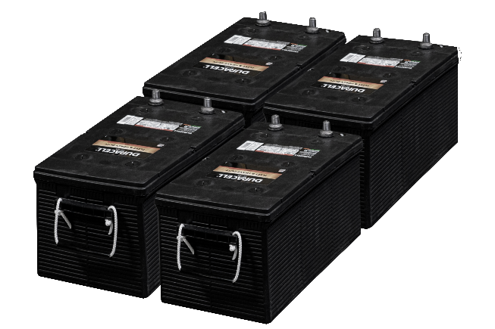
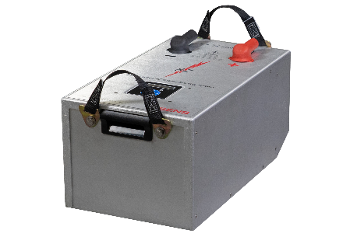
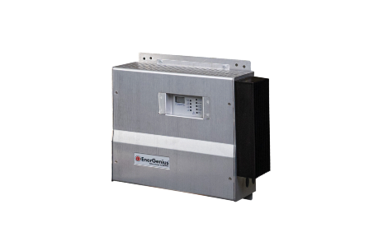
More Power, Less Space
A single SuperTorque 8Z provides equivalent engine starting capacity as (4) 8D lead-acid batteries
Weight – 89 lbs
Area Footprint – 1.7 ft2
System Weight – 680 lbs
Area Footprint – 8.0 ft2

Slide 8
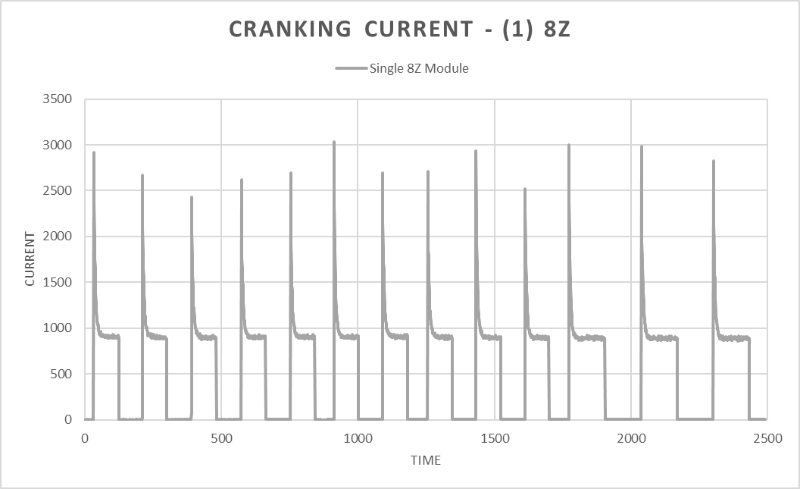
SuperTorque 8Z Power Delivery
2MW 69L Engine
Oil Temp – 60°F
Replacing (4) 8D’s
13 Cranking Cycles:
  - (10) 10s cranks
  - (3) 15s cranks
Fuel system disabled

Slide 9
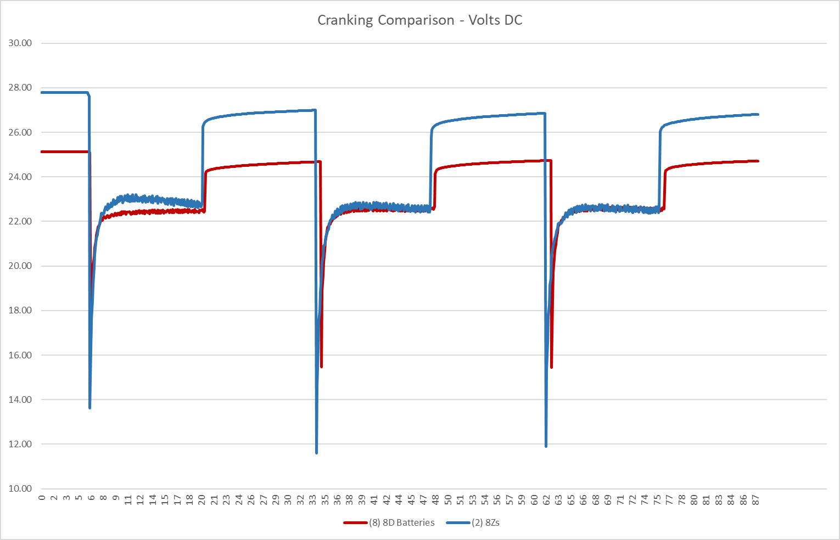
SuperTorque 8Z vs Lead-acid Cranking Volts (DC)
4MW 106L Engine
(8) 8Ds vs (2) 8Zs
(3) 15s Cranks

Slide 10
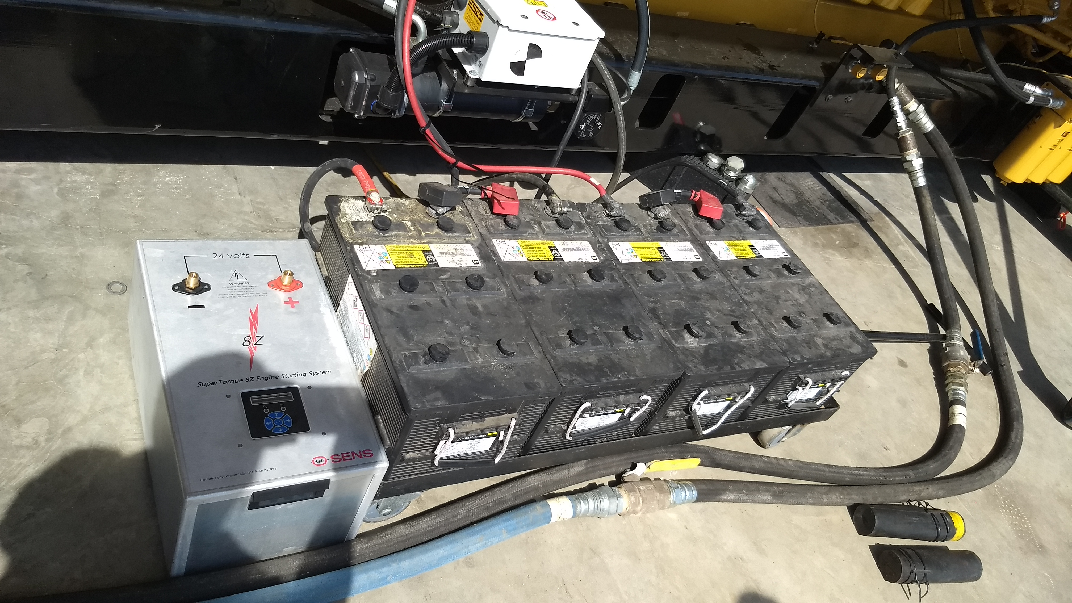
Long Life: 10-Year Standard Warranty
SuperTorque 8Z
10-year full-replacement warranty
No battery maintenance
Typical installation conductors: 4
Lead-Acid Batteries
Replacement every 18-36 months
in critical power applications
Regular maintenance every 6 months
Typical installation conductors: 14
8Z vs. Lead-Acid Batteries

Slide 11
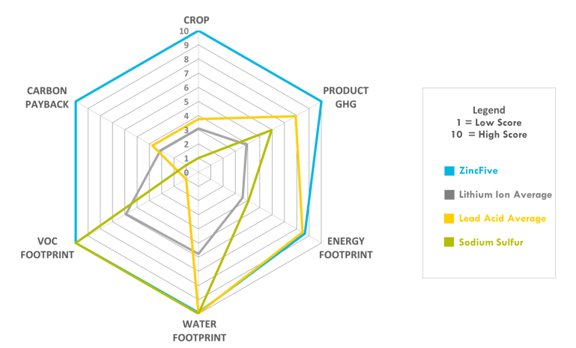
Sustainability
Sources
https://www.rolls-royce.com/sustainability.aspx
https://www.cummins.com/company/esg
https://www.caterpillar.com/en/company/sustainability.html
No solvents or toxic chemicals
96% less water than lithium-ion
Comparable recyclability to lead-acid
Nickel & zinc are 4x and 5x more abundant than lithium
96% lower GHG than lead-acid
No transportation limitations: Ready for air shipment
Superior Genset Starting Battery System for sustainability

Slide 12
SuperTorque 8Z
Summary
Reduces the genset DC system footprint by 75%
Long Life - 10-year Standard Warranty
  Full replacement warranty
  No battery maintenance
Increases genset reliability and safety
The sustainable genset starting choice
50% Lower Total Cost of Ownership than existing DC systems

Slide 13

Any Questions?

