Slide 1
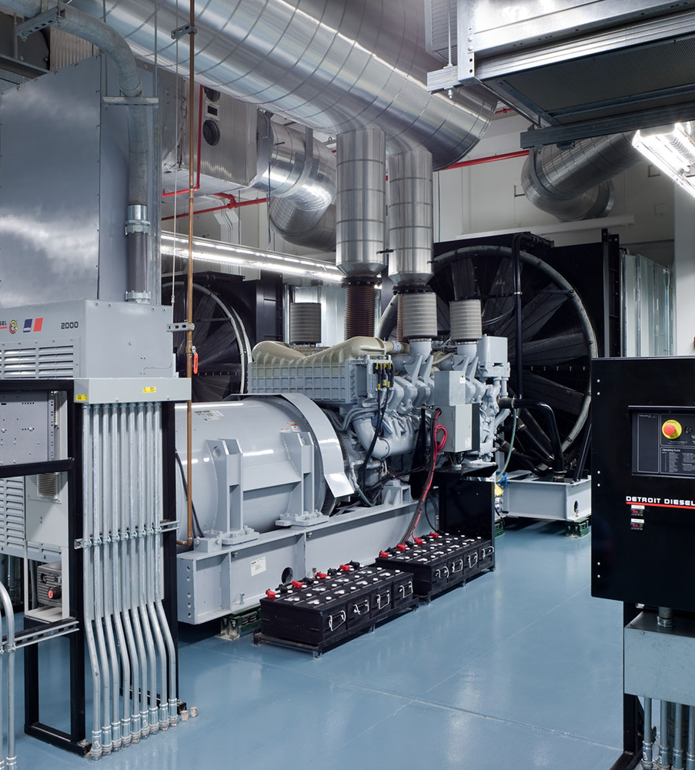
Solving the #1
Genset Problem:
Starting Battery Failure

Slide 2

The Problem
According to Cummins Power Generation:
“Weak or undercharged starting batteries are the most
common cause of standby power system failures.” ¹
1. Power Topic #0074 – Technical Information from Cummins Power Generation
2

Slide 3
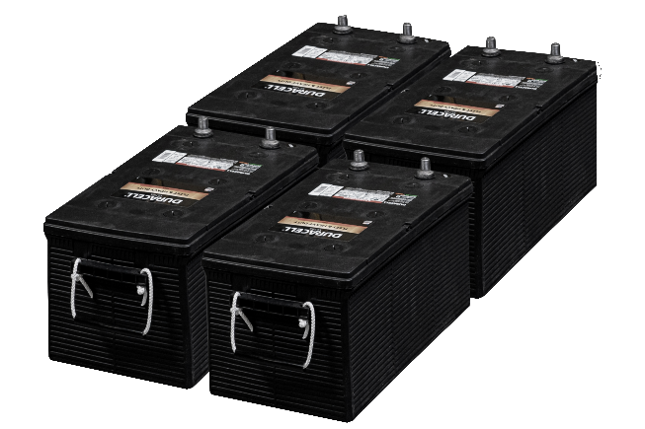
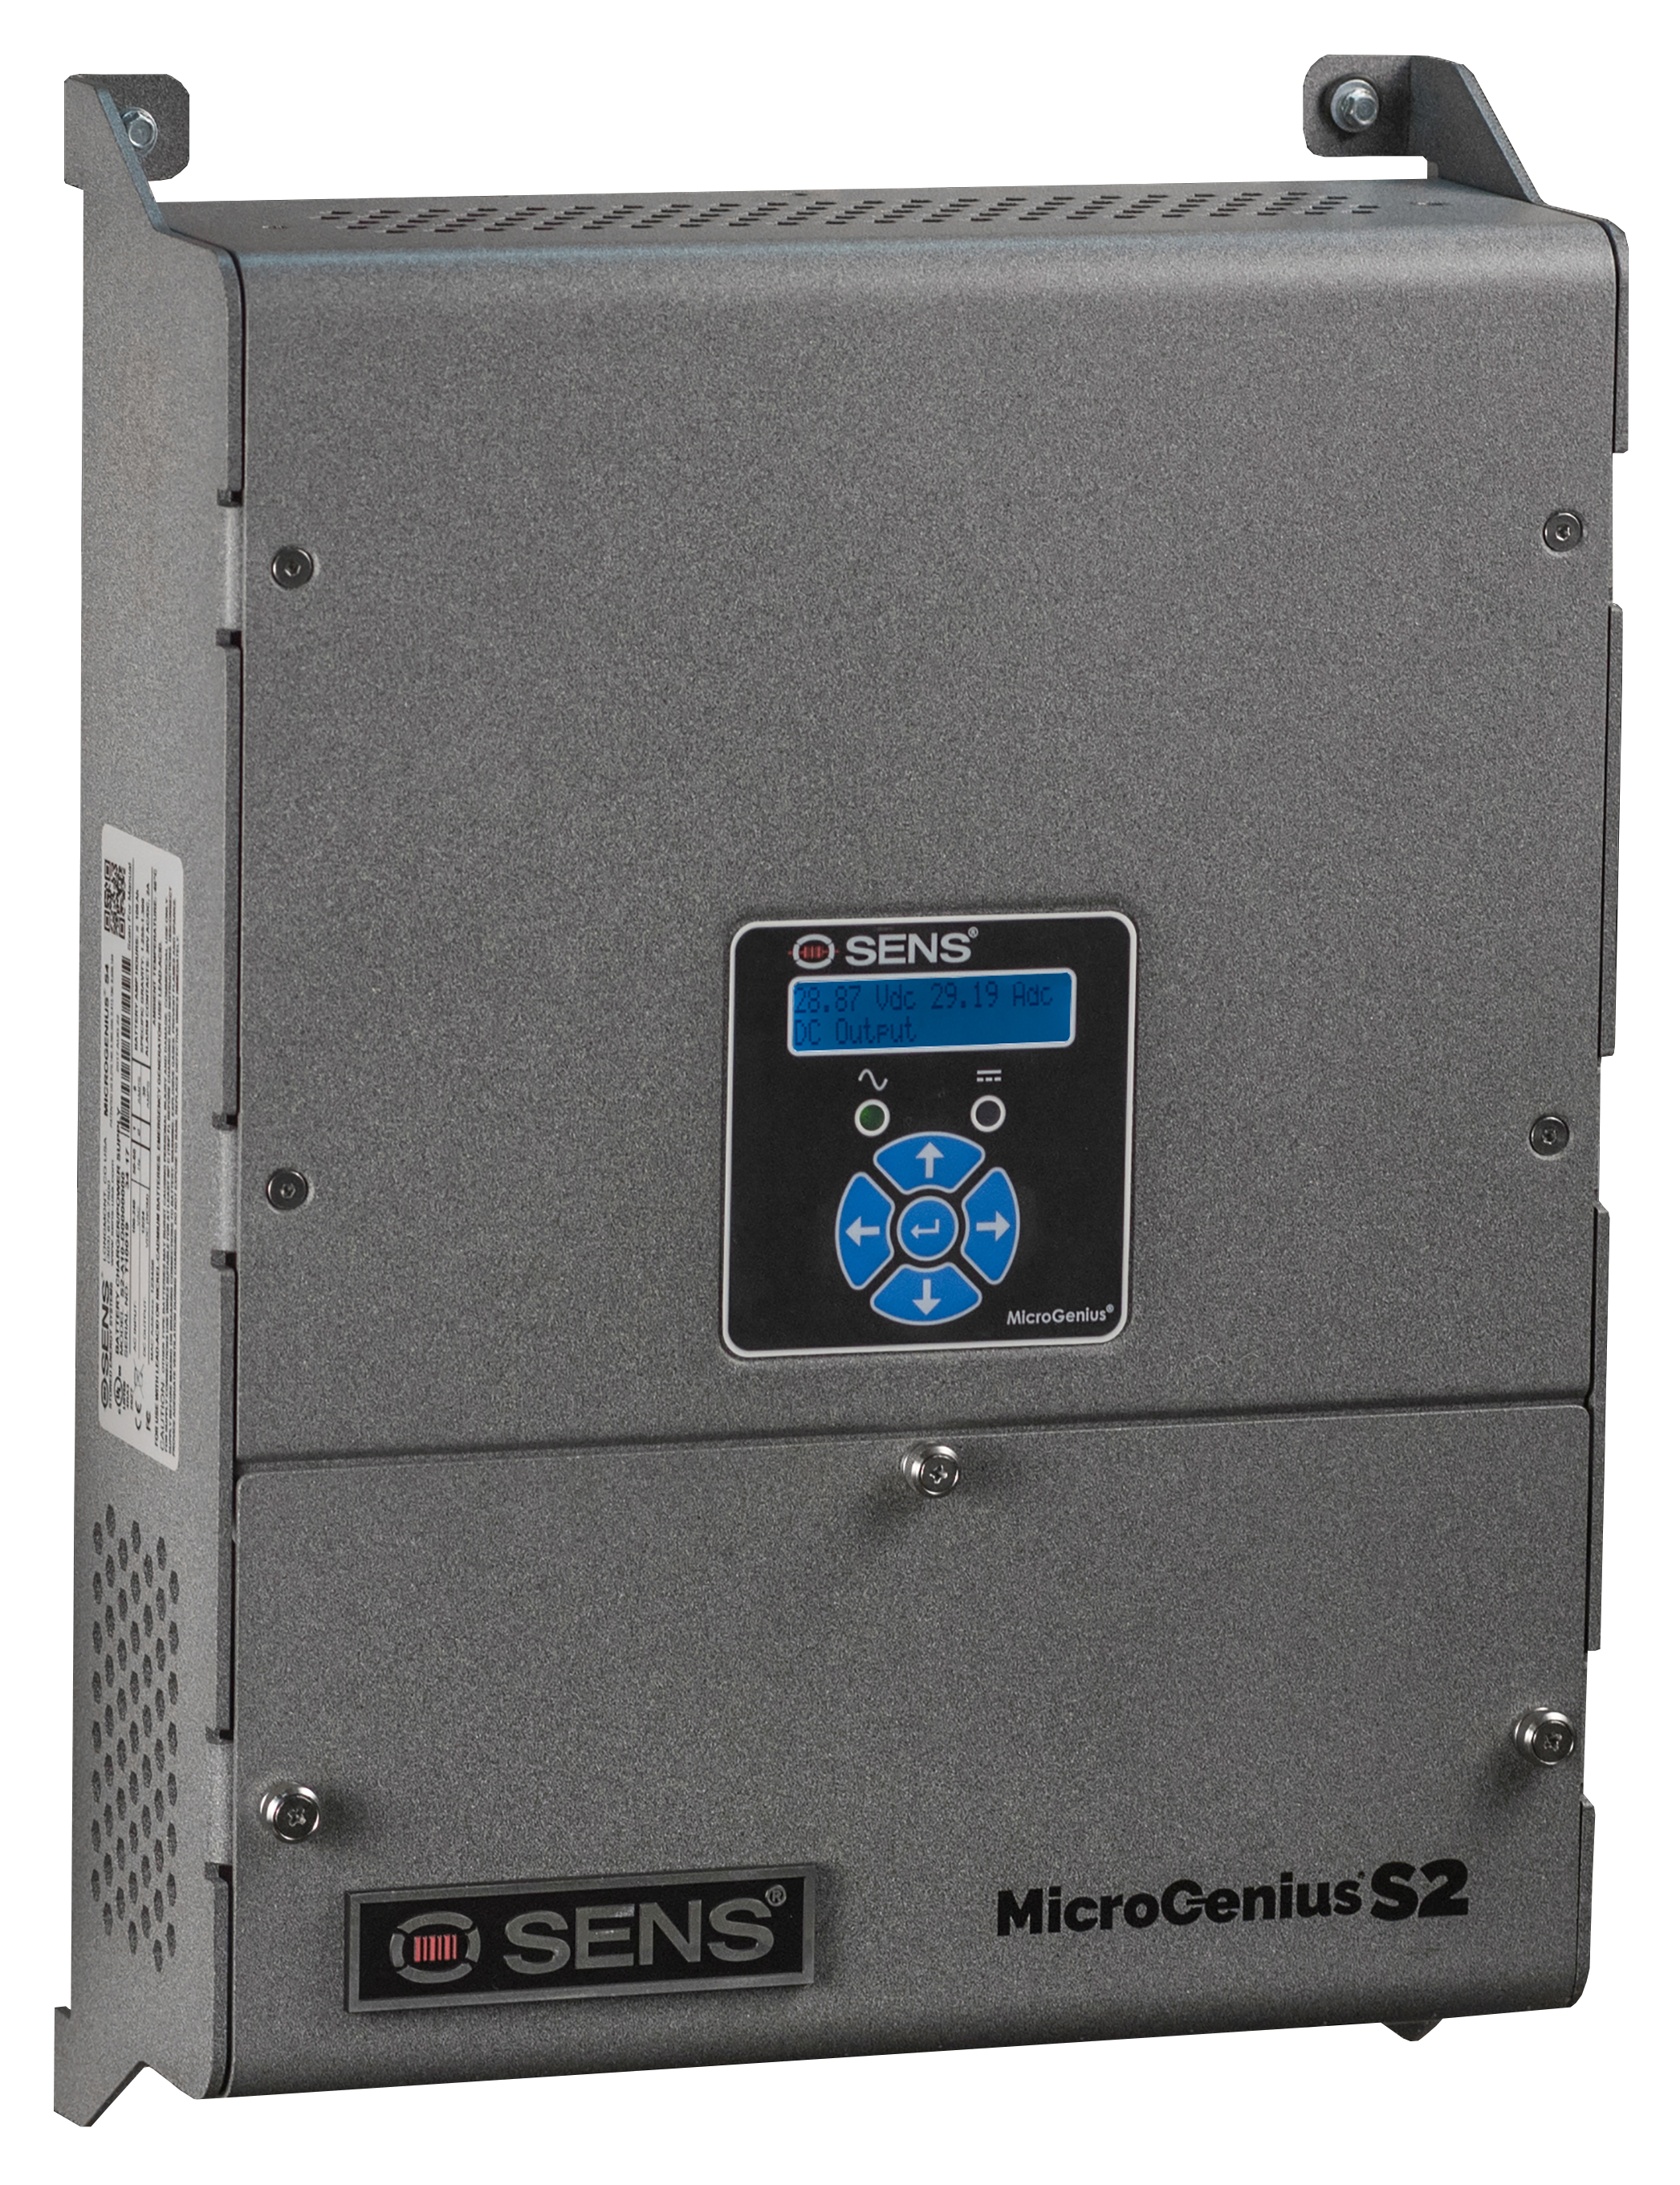
The Genset DC System
Starting Batteries
  12 or 24VDC Engine Battery Systems
  Multiple banks (strings) combined in parallel for greater power capacity
Battery Charger
  Dedicated battery charger required for each battery bank
  24-hour maximum battery recharge, 6-60A charging current is typical
Redundancy
  For critical power infrastructure, redundancy is always recommended & usually required
  Isolated DC power sources are typically specified
    via best battery selectors and redundant batteries/chargers
    via isolated starters with independent batteries/chargers

Slide 4
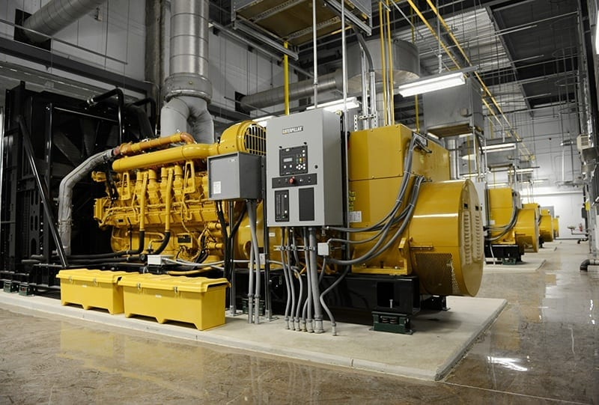
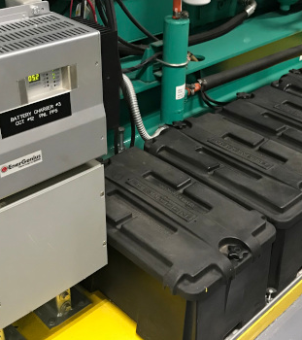
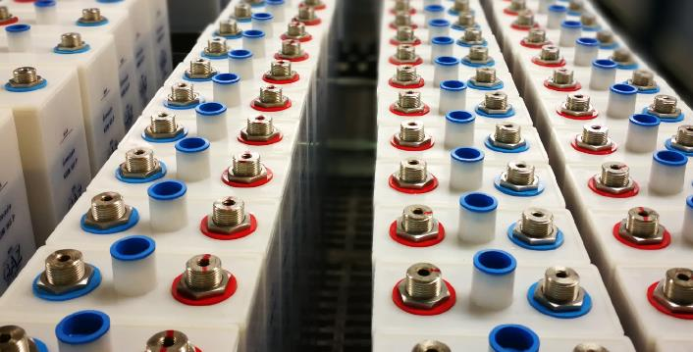
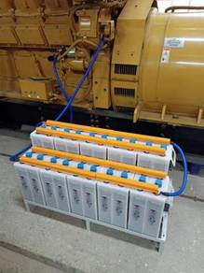
Genset Starting Batteries Today
Lead-Acid Batteries
Low Capex, High Opex
Short life –> 2-3 year replacement cycle
Sudden failure mechanisms, occasional explosions
Regular 1-6 month maintenance by trained technicians
Logistical issues:
  Size, weight, service life, maintenance
Nickel-Cadmium (NiCad)
High Capex, High Opex
10-20 year service life
Complex, space-consuming installations
Maintenance by trained technicians
Logistical issues:
  Cost, complexity, disposal

Slide 5



Challenges with Genset Batteries
Genset Float Charge Environment
Operations & Logistics
DC System Specification

Slide 6
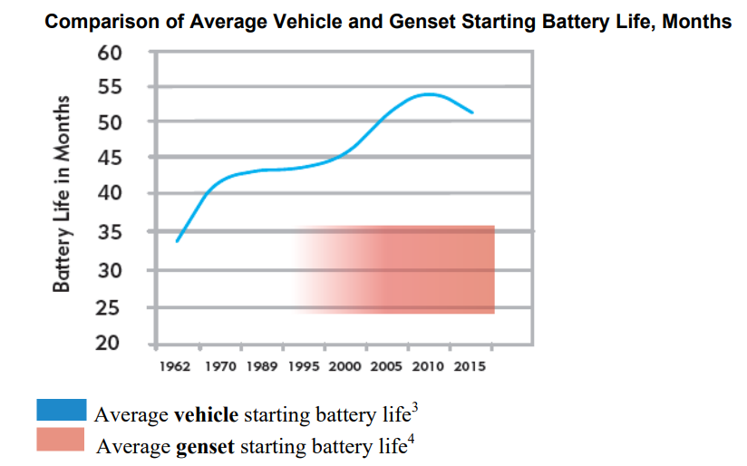
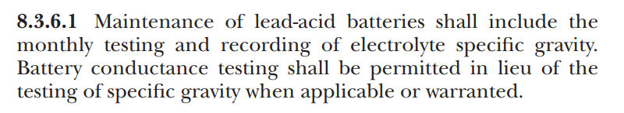
Challenge #1 – Short Life of Lead-acid Batteries
Unique challenges for lead-acid batteries in the genset environment:
Constant Float Charge
  Flooded lead-acid batteries are designed for automotive applications with intermittent charging
A sudden failure mechanism
Short lead-acid life necessitates NFPA 110 advice:
Replacement of all lead-acid batteries every 24-30 months
Dedicated monthly battery testing

Slide 7
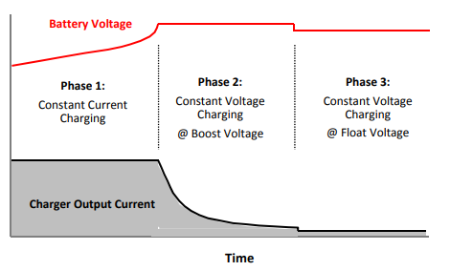
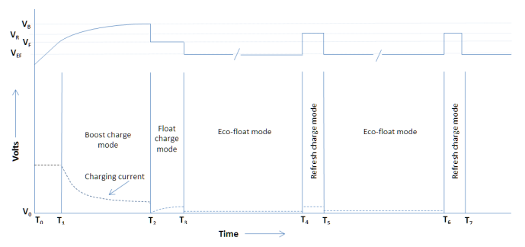
Charging Advancements Help…
Variable Boost | Dynamic Boost
Boost charging tailored to battery discharge
Prevents battery overcharge
Eco-float | Refresh | HELIX
Simulates an automotive type charging profile to extend battery life
Extends genset battery life by 60-100%

Slide 8
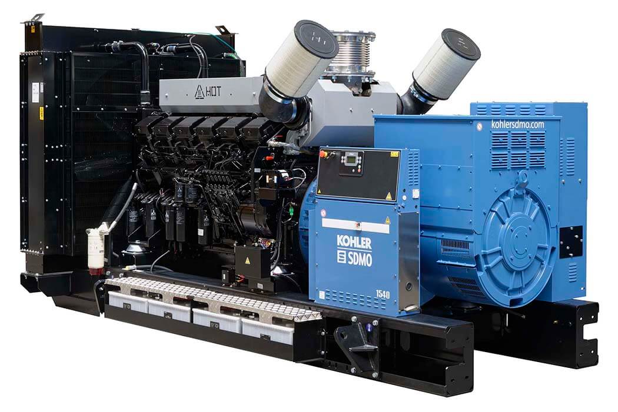
Challenge #2 – Operations & Logistics
Lead-acid Batteries
NFPA 110 requires monthly maintenance
NFPA 110 requires 24-30 month replacement
Nickel-Cadmium
Complex Systems
Expensive Systems
Disposal difficulties
Theoretical Example, YMMV
Facility with 10 generators
  4 lead-acid batteries per genset
Battery maintenance every month
Battery replacement every 2 years
240 truck rolls over 10 years for maintenance and replacements
  5 generators per truck roll
2,400+ labor hours over 10 years for maintenance and replacements
  2 labor-hours for each battery maintenance & replacement

Slide 9
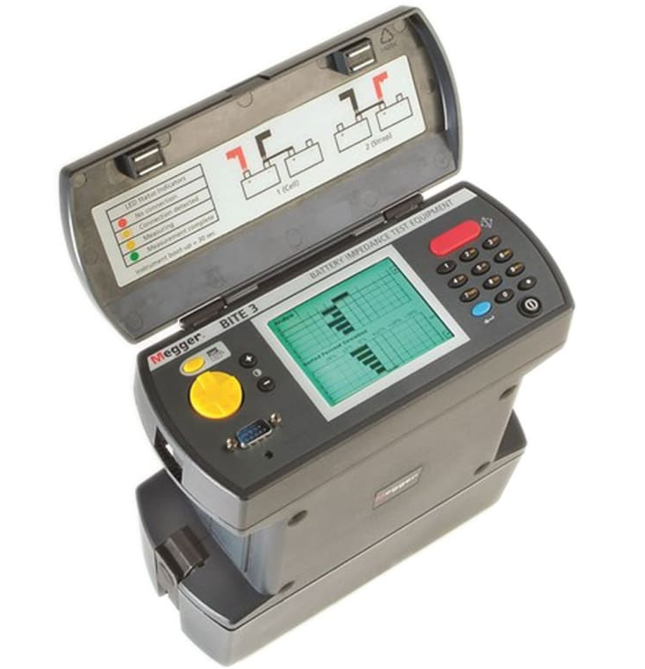
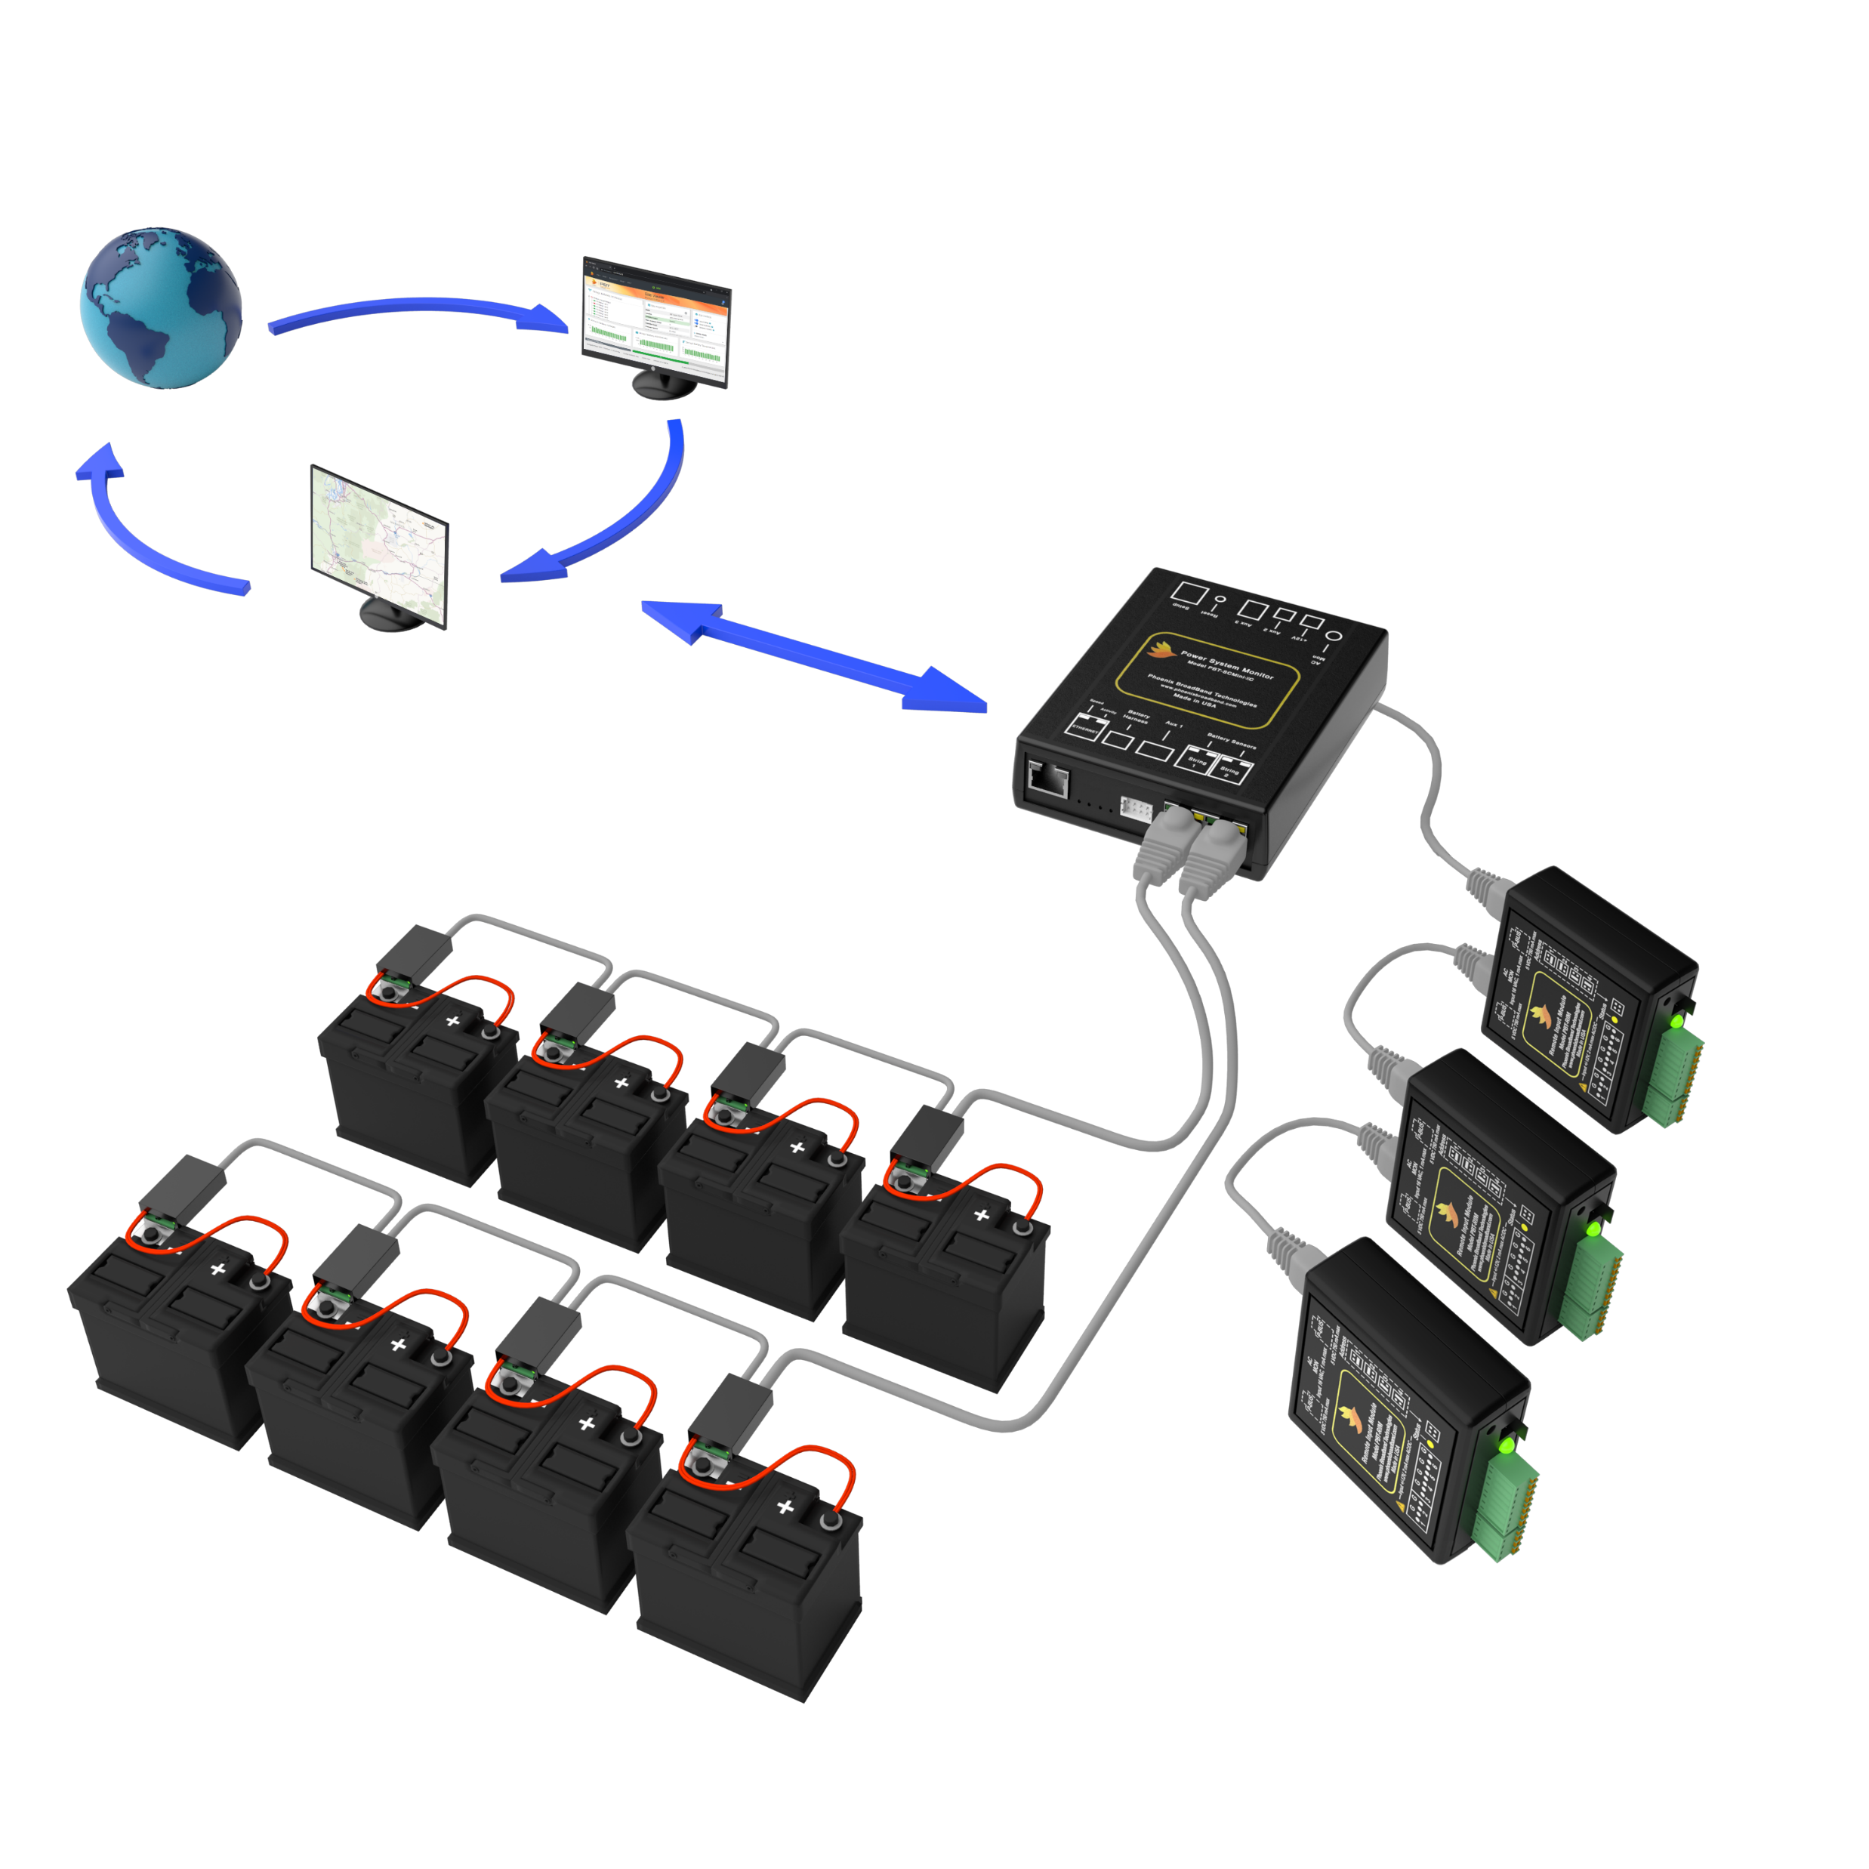
Monthly NFPA 110 Maintenance
What maintenance?
Flooded vs AGM
What is conductance testing?
Manual or automated
Automated genset battery monitoring eliminates the need for monthly manual conductance and specific gravity testing

Slide 10
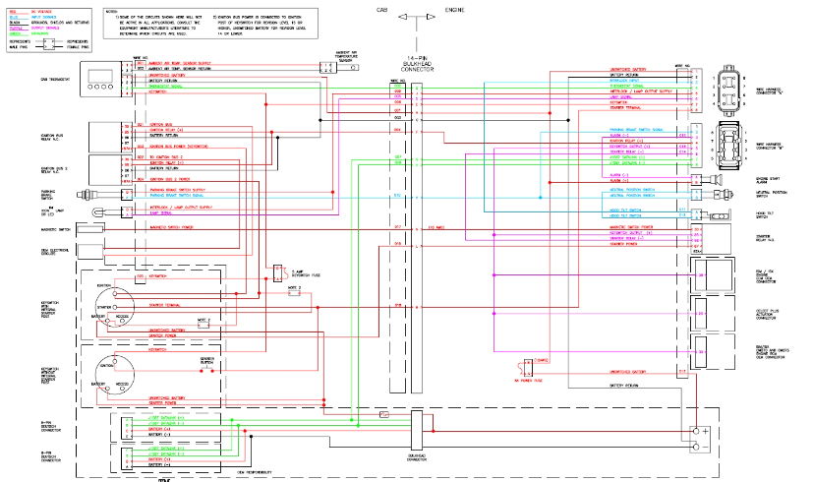
Challenge #3 – System Specification
Component Specification
Component Integration
Field Installation
System Integration
Engine | System Components | Large Power Components | Field Wiring Conductors
1.5MW | (4) 8Ds, (1) charger | 5 | 12
2.25MW | (2) Banks of (4) 8D batteries, (2) chargers and a BBS | 11 | 20
3MW | (3) Banks of (2) 8D batteries, (3) chargers | 9 | 24
4MW | (2) Banks of (6) 8D batteries, (2) chargers and a BBS | 15 | 21

Slide 11
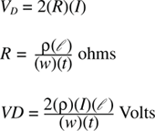
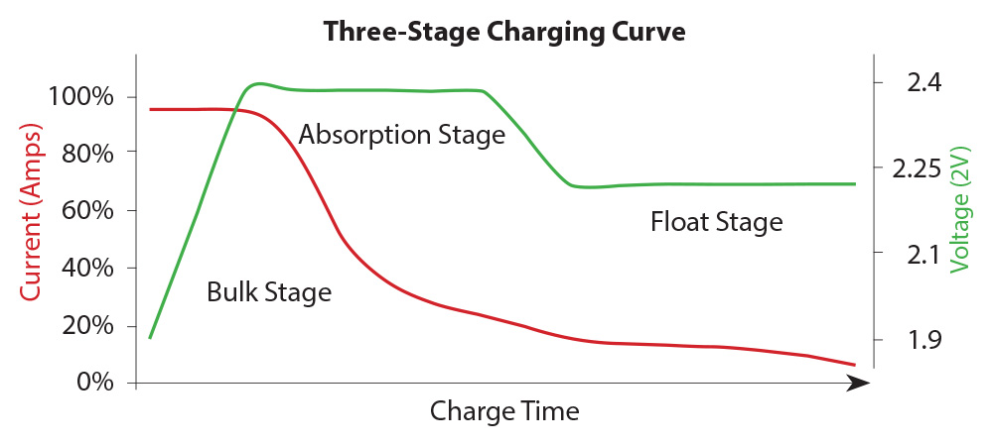
Challenge #3 – System Specification
Necessary Design Factors
Battery chemistry design margin
Environment & temperature
Engine Properties (displacement, oil, continuous loads, etc)
Voltage Drop
System Design and Compatibility
Charging profiles and settings

Slide 12
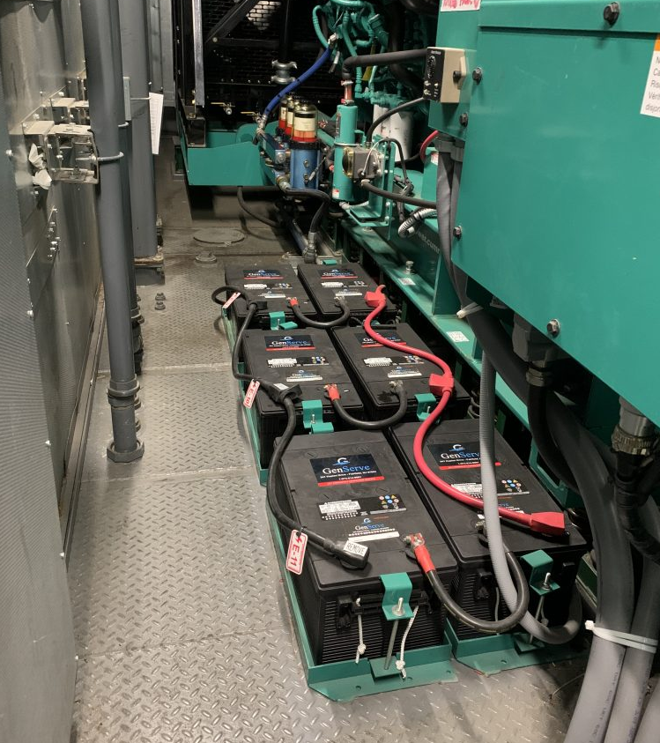
Existing Solutions - Summary
Lead-acid Batteries
The industry standard
Low upfront cost
Unique challenges in gensets lead to reliability challenges
Require frequent replacement & regular maintenance
Nickel-cadmium Batteries
For applications prioritizing reliability and long life
High upfront cost
Complex, large systems

Slide 13
Alternatives
Super Capacitors
Lithium-ion
Nickel-zinc

Slide 14
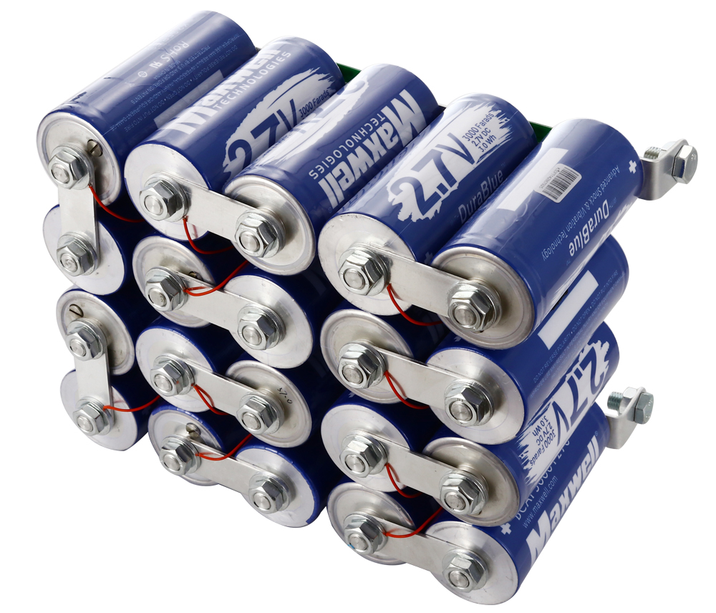
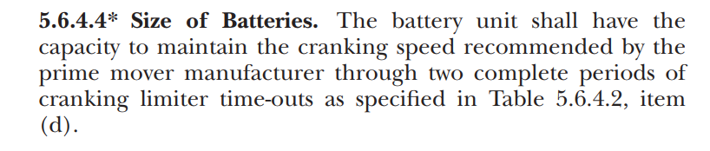

Super Capacitors
Static electric field energy storage
Excellent temperature performance
Eco-friendly
Compact
Low energy density
Unable to sustain long-cranking periods
Not cost effective for NFPA 110 engine starting applications
NFPA 110 requires 90 seconds of engine cranking

Slide 15
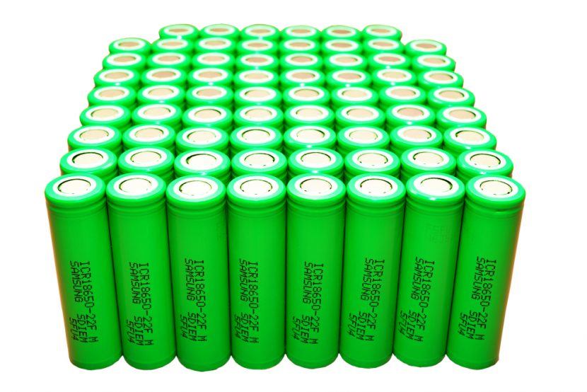
Lithium-ion
Long Life
High energy density
Not suited for engine starting applications
Requires BMS system
  Challenges for BMS during engine start
  Max current suited for automotive, not large gensets
Poor low-temperature performance
Catastrophic failure risk
Expensive

Slide 16
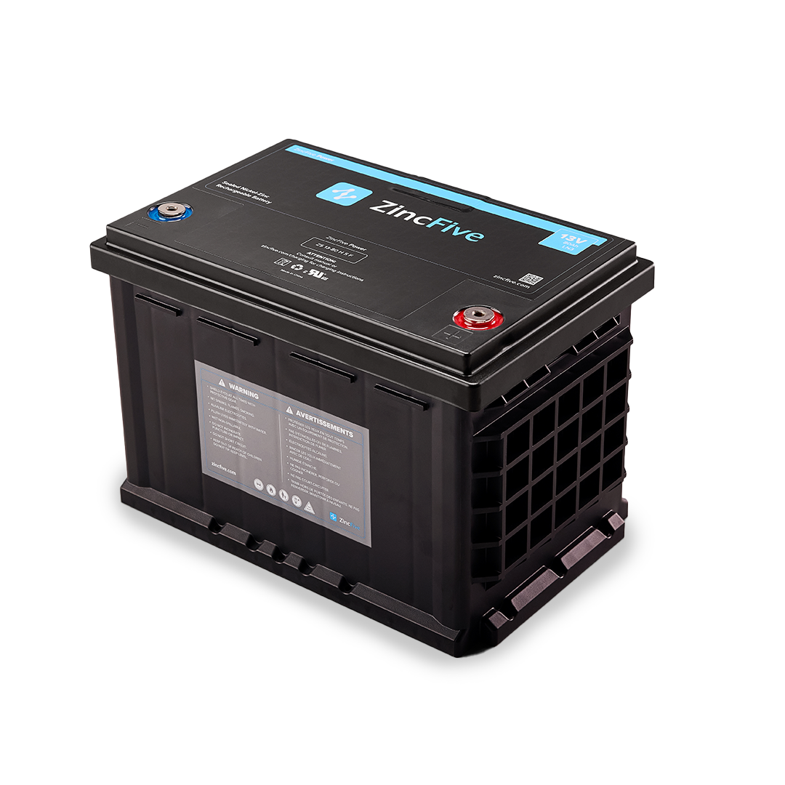
Nickel-zinc
High discharge current applications
Datacenter UPS
Engine Starting
Delivers reliable performance, safely
High engine-cranking performance even at low state-of-charge
Much more efficient use of battery capacity compared with lead-acid
Sustainable
Higher Upfront Cost

Slide 17
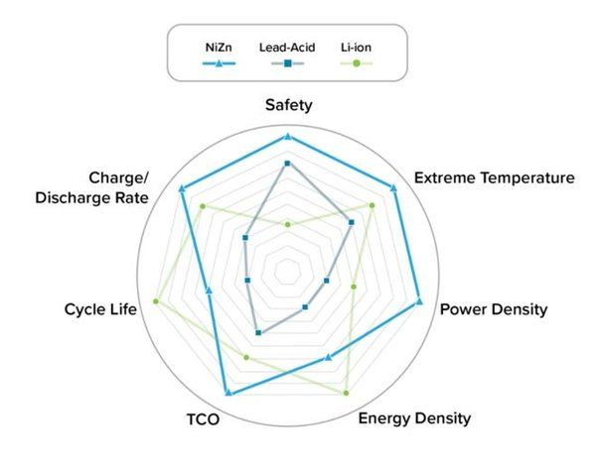
Alternatives Comparison
Super Capacitors and Lithium-ion face challenges in the genset engine-start environment
Not commercially viable at this time
Nickel-zinc is the best genset starting battery alternative so far…

Slide 18

Nickel-zinc vs Lead-acid Comparisons
13% of the weight | 22% of the footprint of lead-acid systems
Nickel-zinc Batteries
  15-year service life
  No battery maintenance
  96% lower GHG emissions
Lead-acid Batteries
  Replacement every 24-30 months
  Regular maintenance every month
  25x more GHG emissions
System Weight – 70 lbs
System Weight – 560 lbs

Slide 19
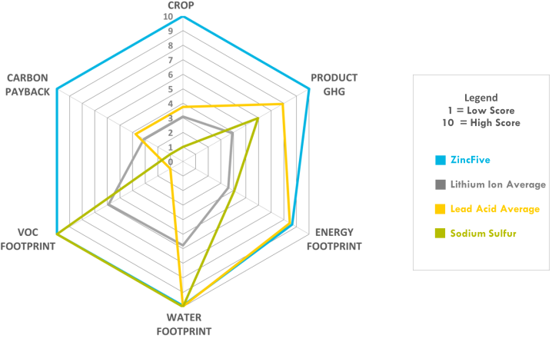




Nickel-Zinc – Sustainable Battery Technology
96% lower GHG emissions than lead-acid
No solvents, toxic chemicals or heavy metals
Recycled at low temperatures
Sustainability Factors
Manufacturing Emissions | Logistic Emissions | Recycling Emissions | Water Usage | Materials
Number of Trees Required to Offset Lifetime CO2e Emissions from Starter Battery Use ( = 10 Mature Trees)
NiZn 40 KW Starter Battery
Solution Lifetime Emissions
Lead Acid 40 KW Starter Battery
Solution Lifetime Emissions

Slide 20
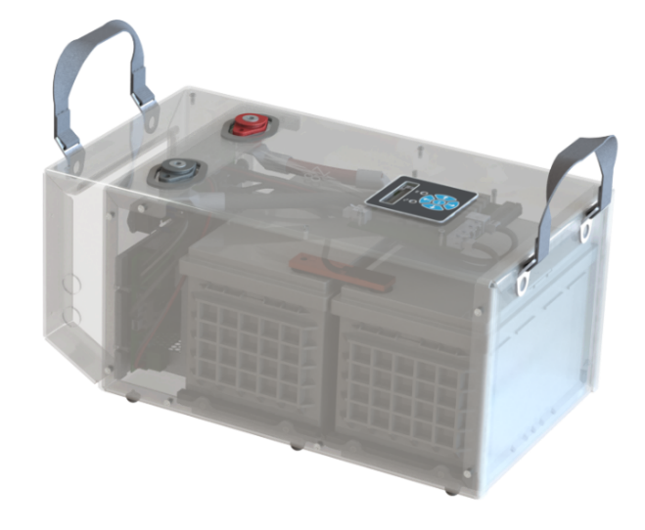
Integrated Engine Starting Systems
With nickel-zinc battery energy density, weight, and life advancements…
integrated systems are now commercially viable
Eliminates genset DC system complexity
Simplifies specification, integration, logistics
  Specify and order a single part number
  75% reduction in space required
  Simple installation
  Eliminate regular battery maintenance and replacement

Slide 21
Problems that have been with us for decades…
Are now within our grasp to retire
Monthly manual lead-acid conductance and specific gravity monitoring
Automated lead-acid conductance monitoring
DC system complexity
Integrated genset engine starting systems
Required regular battery maintenance
Long-life, maintenance free batteries
Battery size and weight, and need for frequent replacement
Super high-rate, compact, nickel-zinc batteries
21

